Slide 1
Cytron Maker Nano RP2040

Slide 2
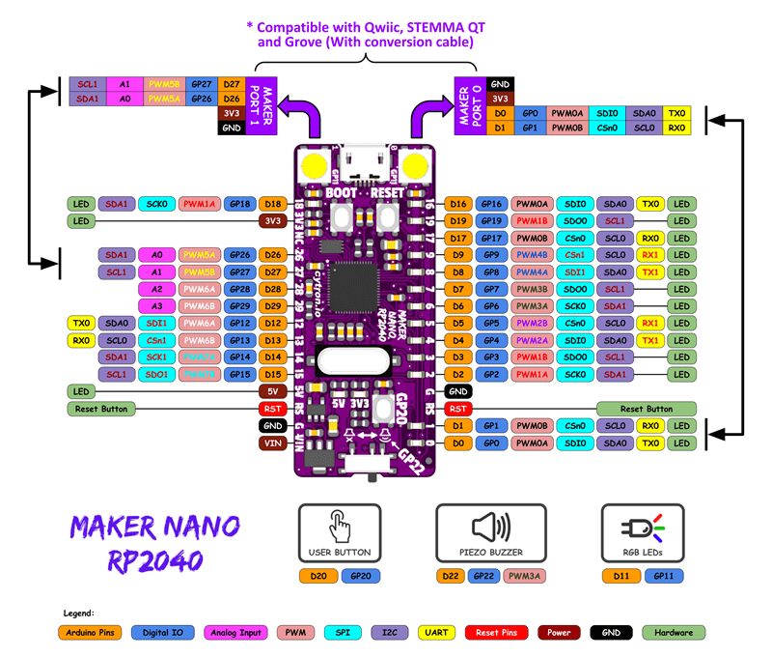
cytron-nano-rp2040-pinout

